Slide 1
FEA Lab Project: Static & Transient Analysis
Faizan Munir | ME 1900 | Mechanical Engineering
Instructor: Engr Affan Ahmed Khan

Slide 2
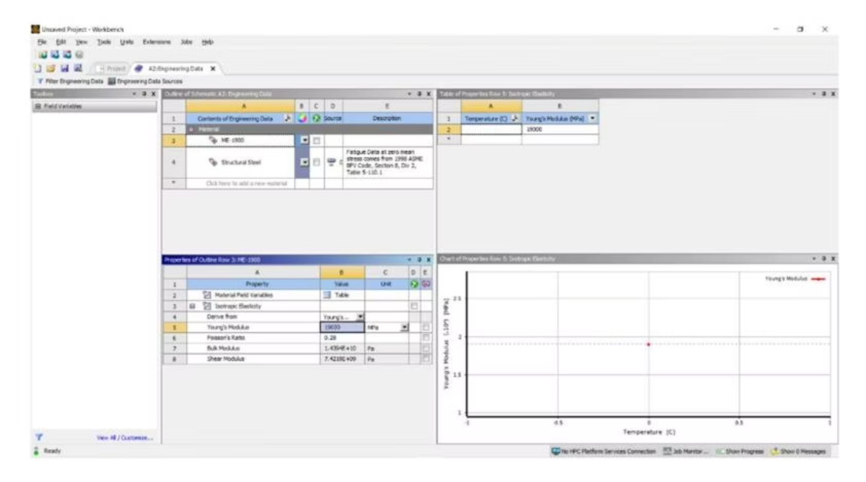
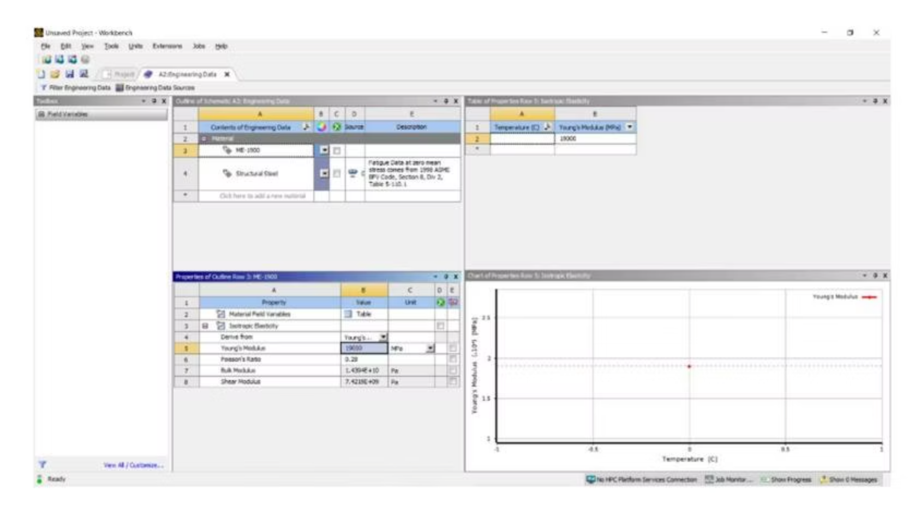
Introduction & Material Properties
1
2
3
Project Overview
Purpose
Material: ME-1900
This report details Static Structural and Transient Structural analyses on a pentagon-based 3D extruded geometry.
To observe the structure's response to static and time-dependent varying loads.
Young's Modulus: 19000 MPaPoisson's Ratio: 0.28Density: 7850 kg/m³
Material Properties (Static)
Material Properties (Transient)

Slide 3
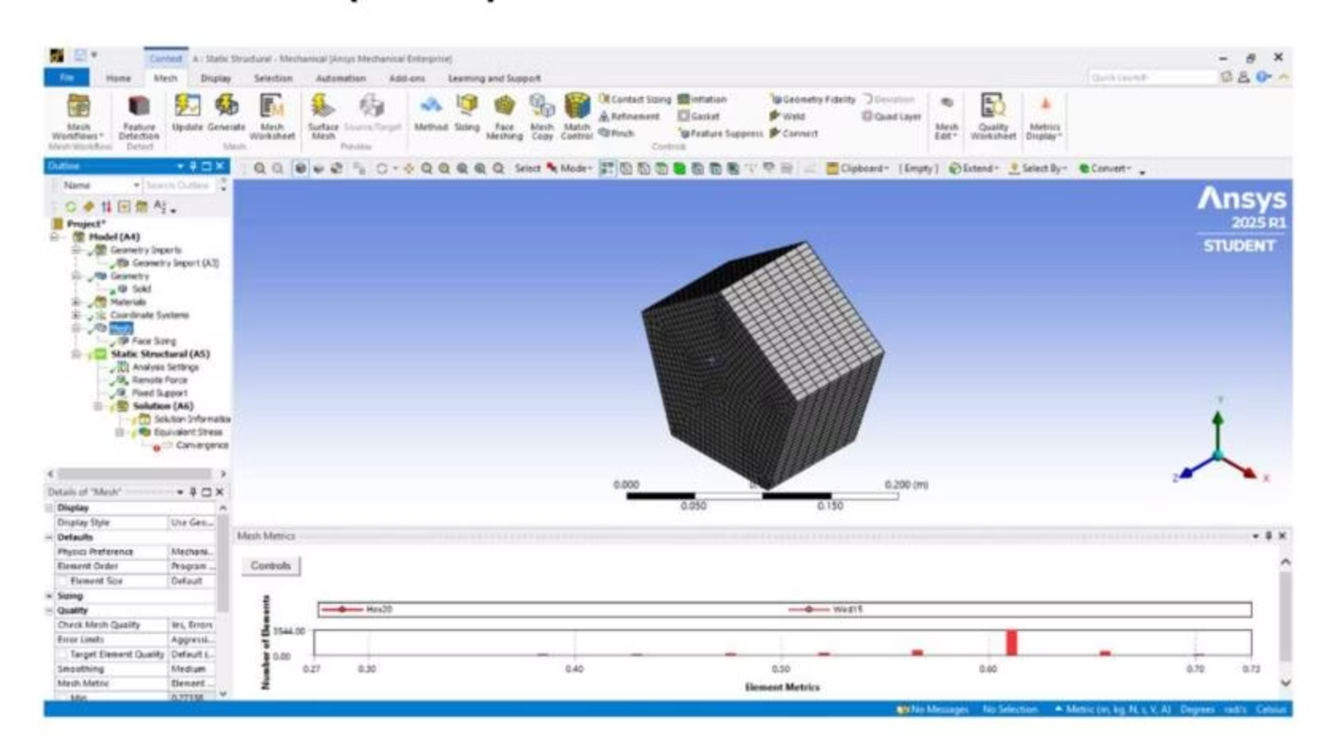
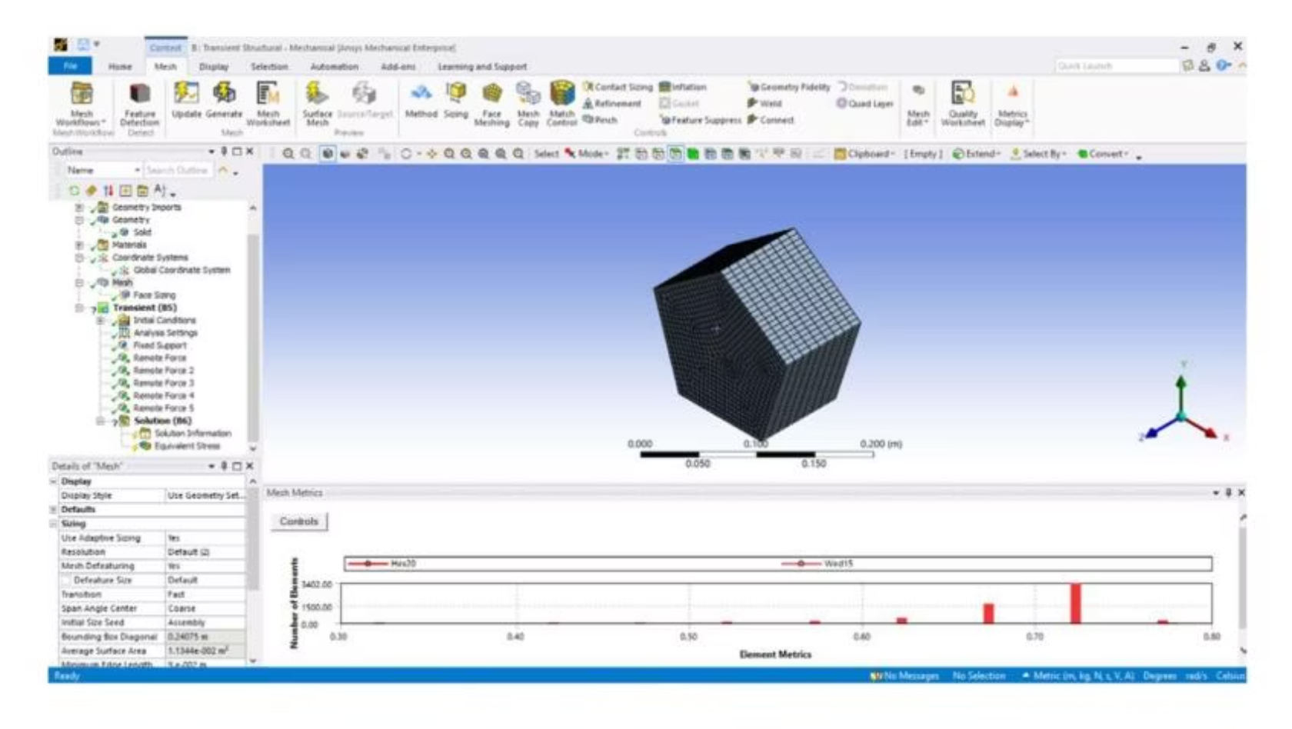
Geometry Creation & Meshing
A pentagon shape was sketched on the XY-plane and extruded to a depth of 0.09 m. ANSYS automatically generated a mesh using default controls, including Hex20/Wedge elements.
Sketch (Static)
Extruded Body (Static)
Sketch (Transient)
Extruded Body (Transient)
Mesh Metrics (Static)
Mesh Metrics (Transient)

Slide 4
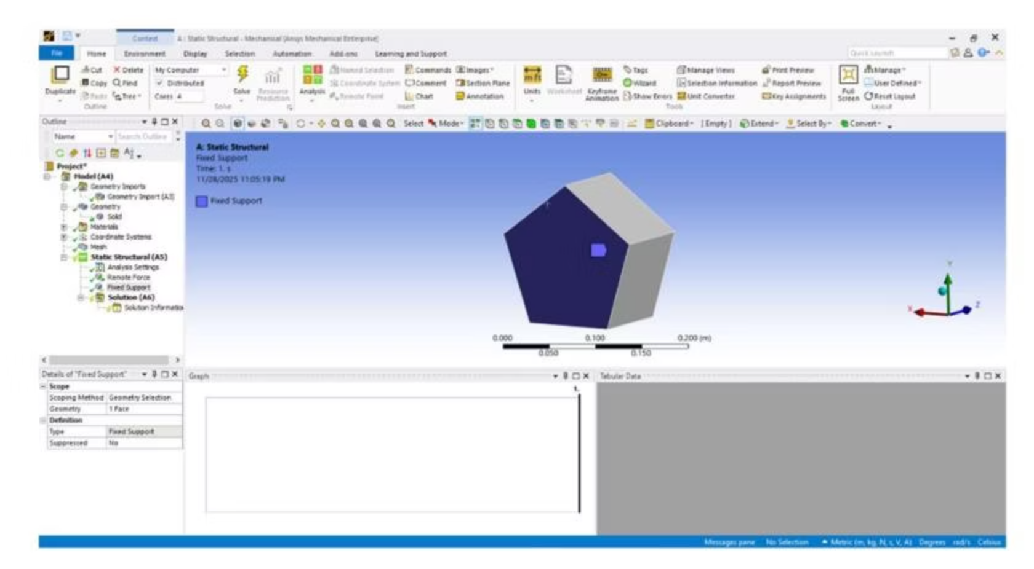
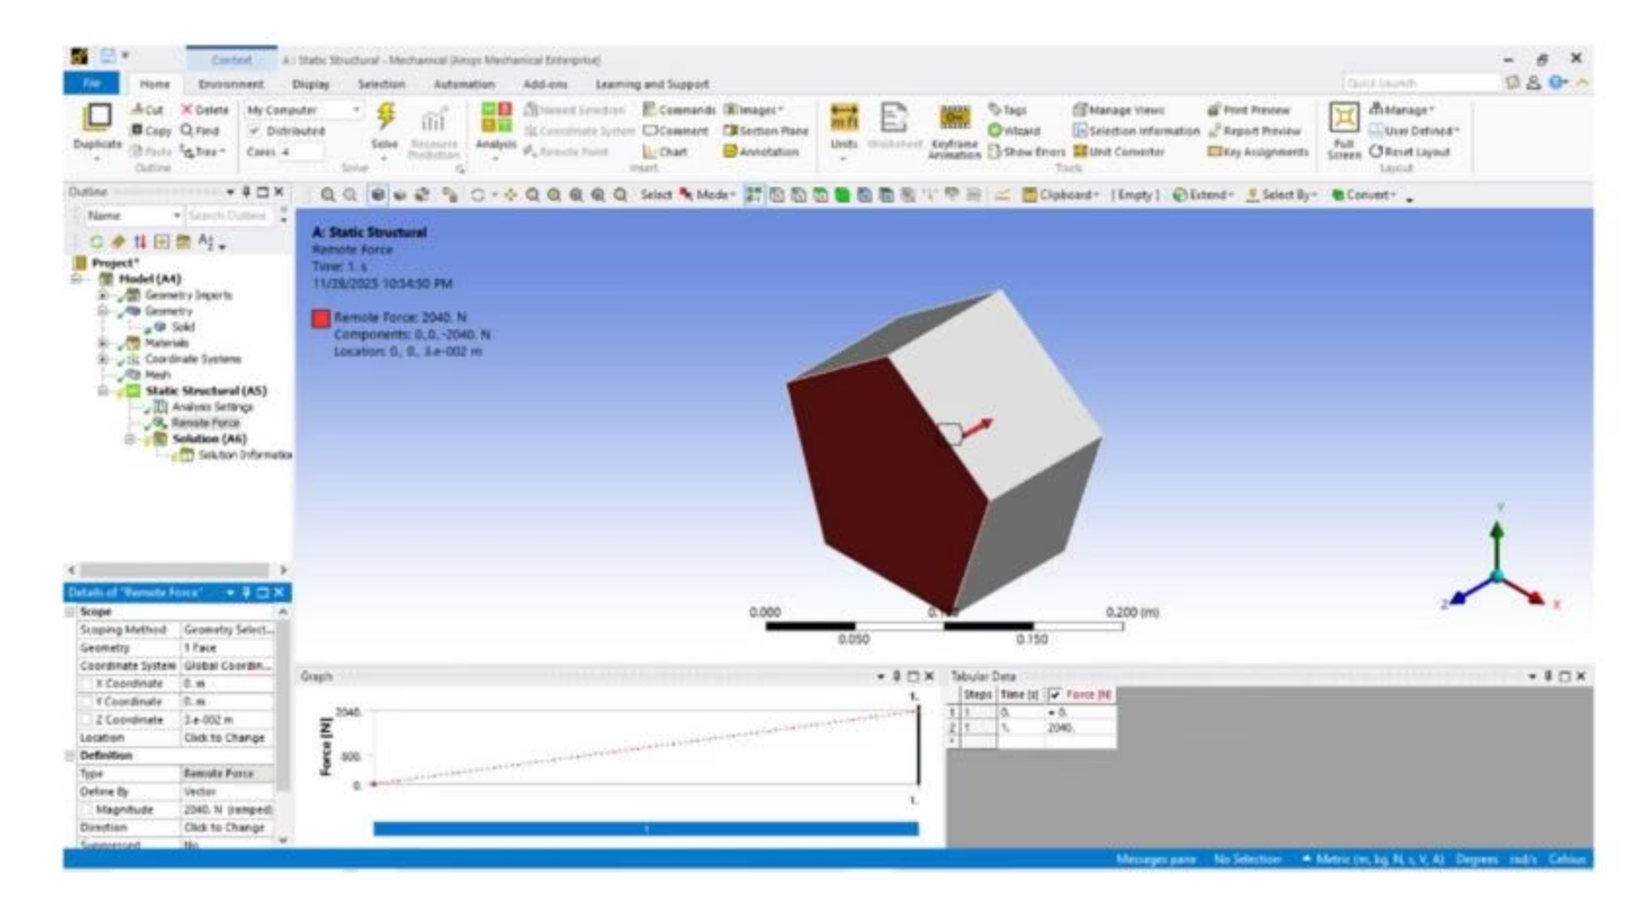
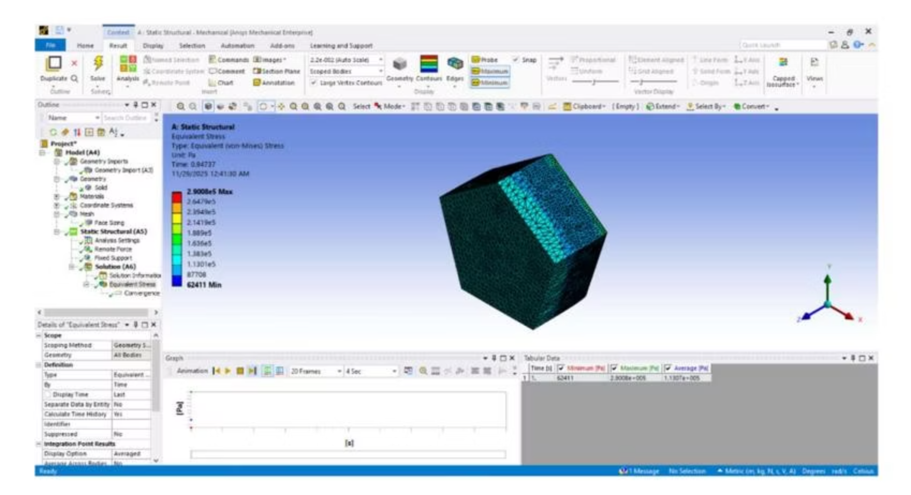
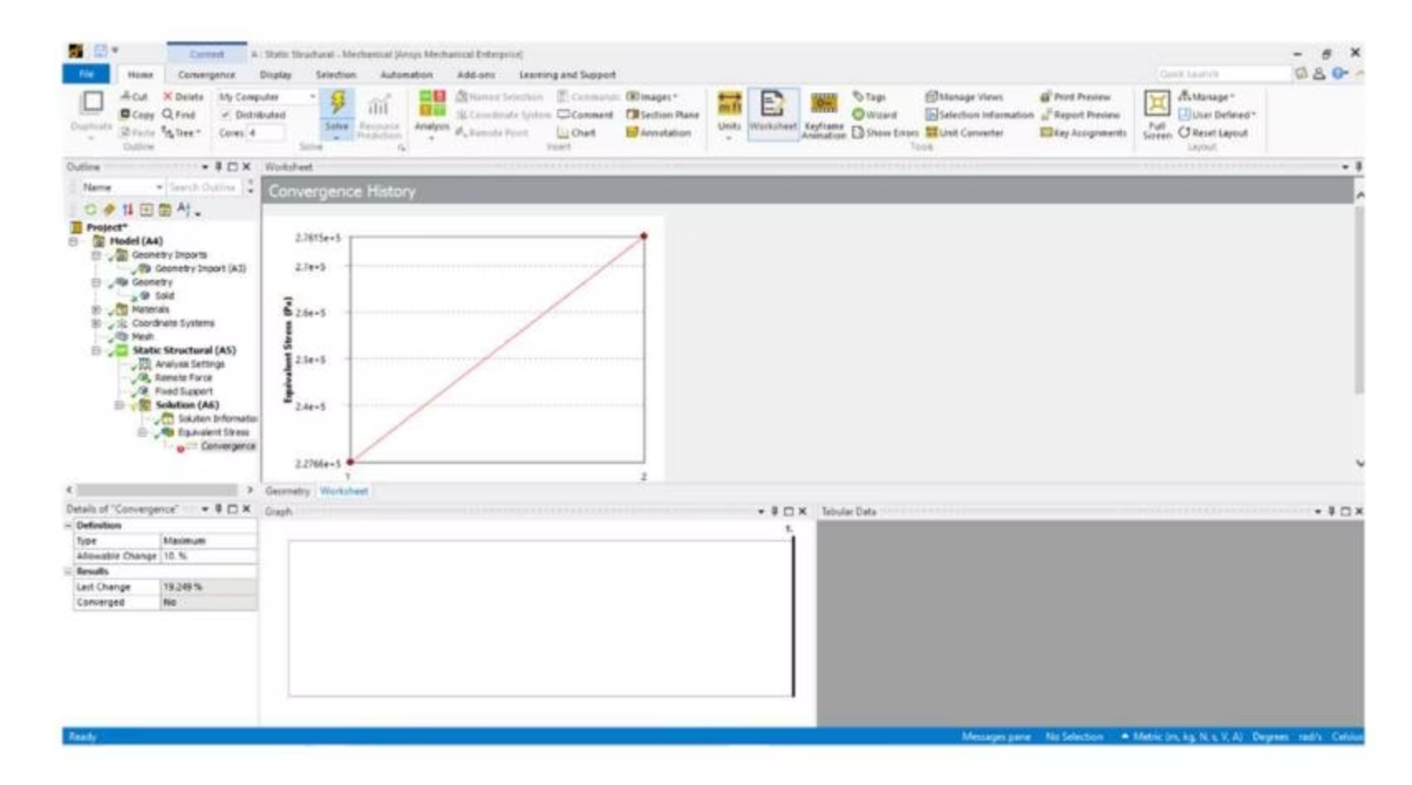
Static Structural Analysis
Boundary Conditions
Static Results
Fixed Support on one face.
Equivalent (von-Mises) stress distribution obtained.
Remote Force of 2040 N applied on opposite face (ramped).
Maximum stress visible on the loaded face region.
Convergence not achieved due to large relative change (approx. 19%).
Fixed Support (Static)
Remote Force (Static)
Equivalent Stress (Static)
Convergence Plot (Static)

Slide 5
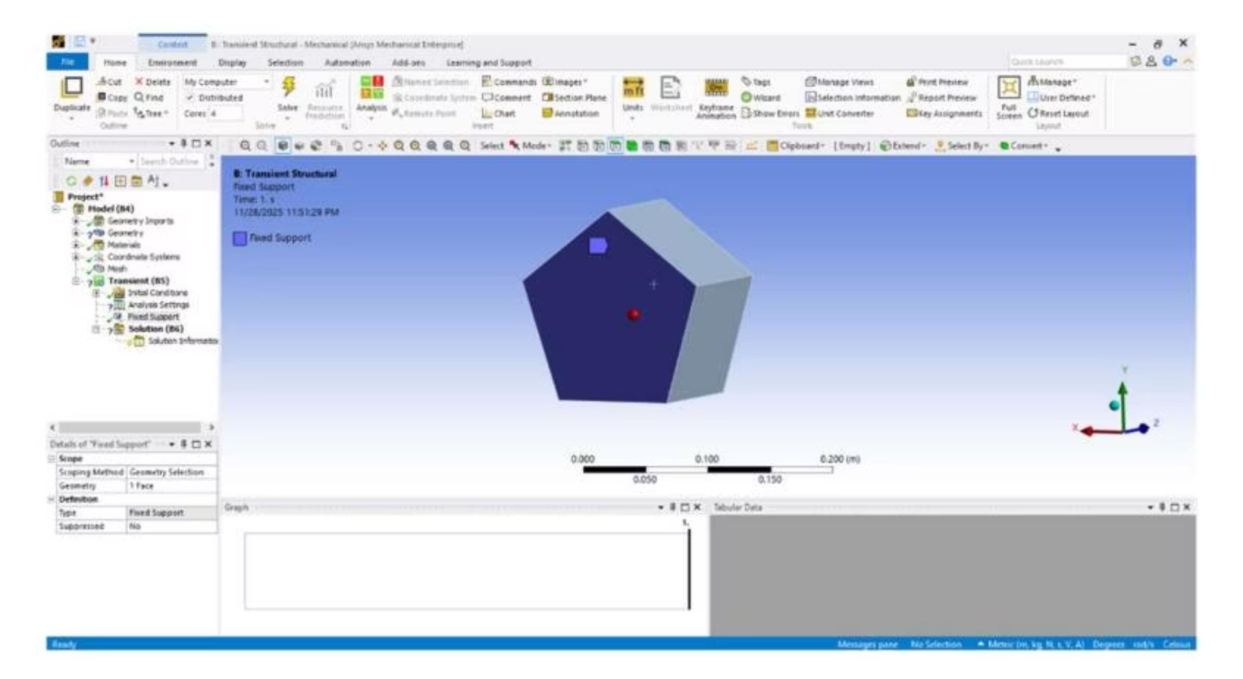
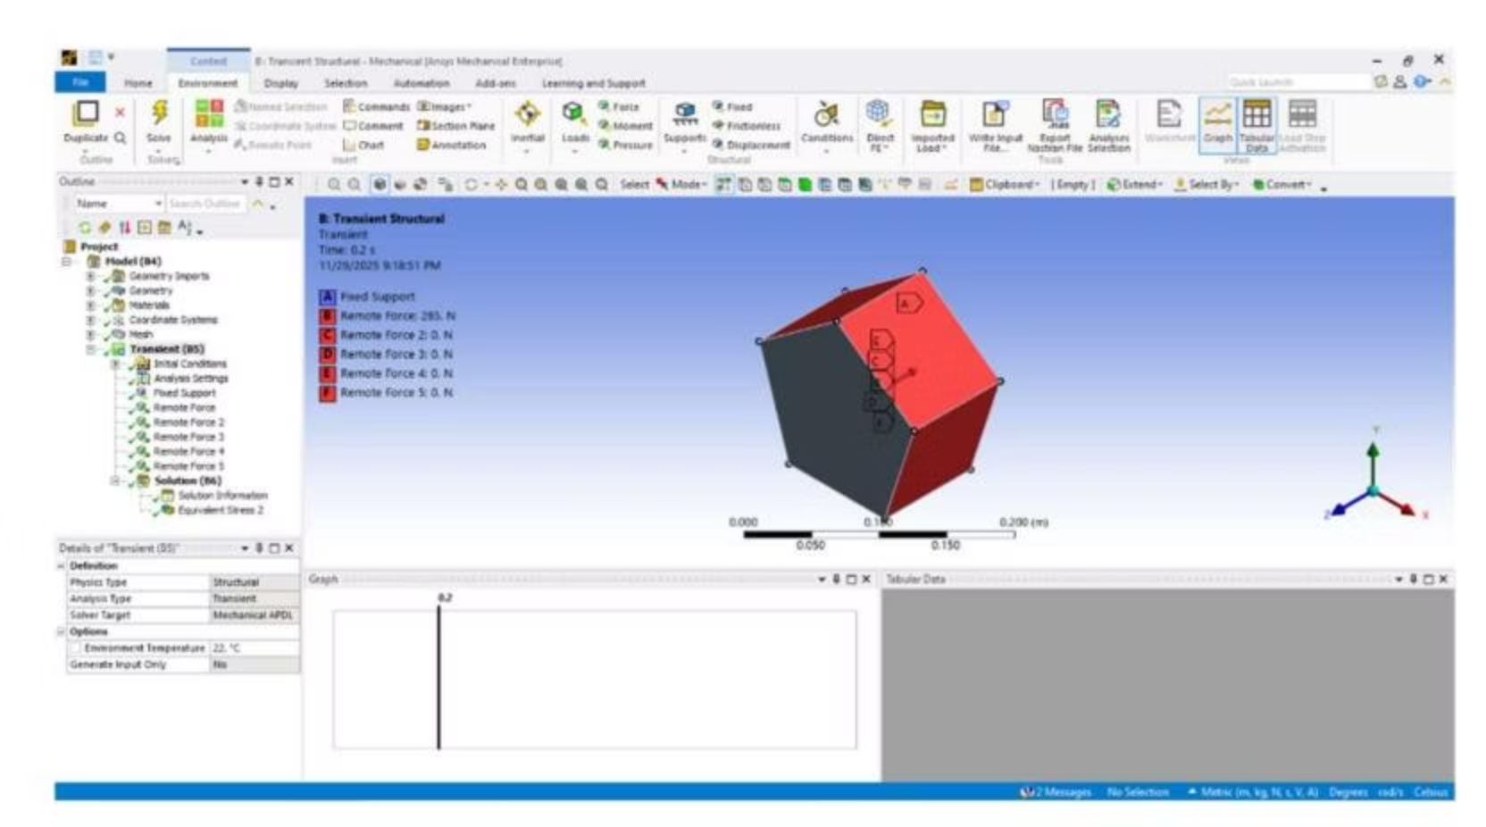
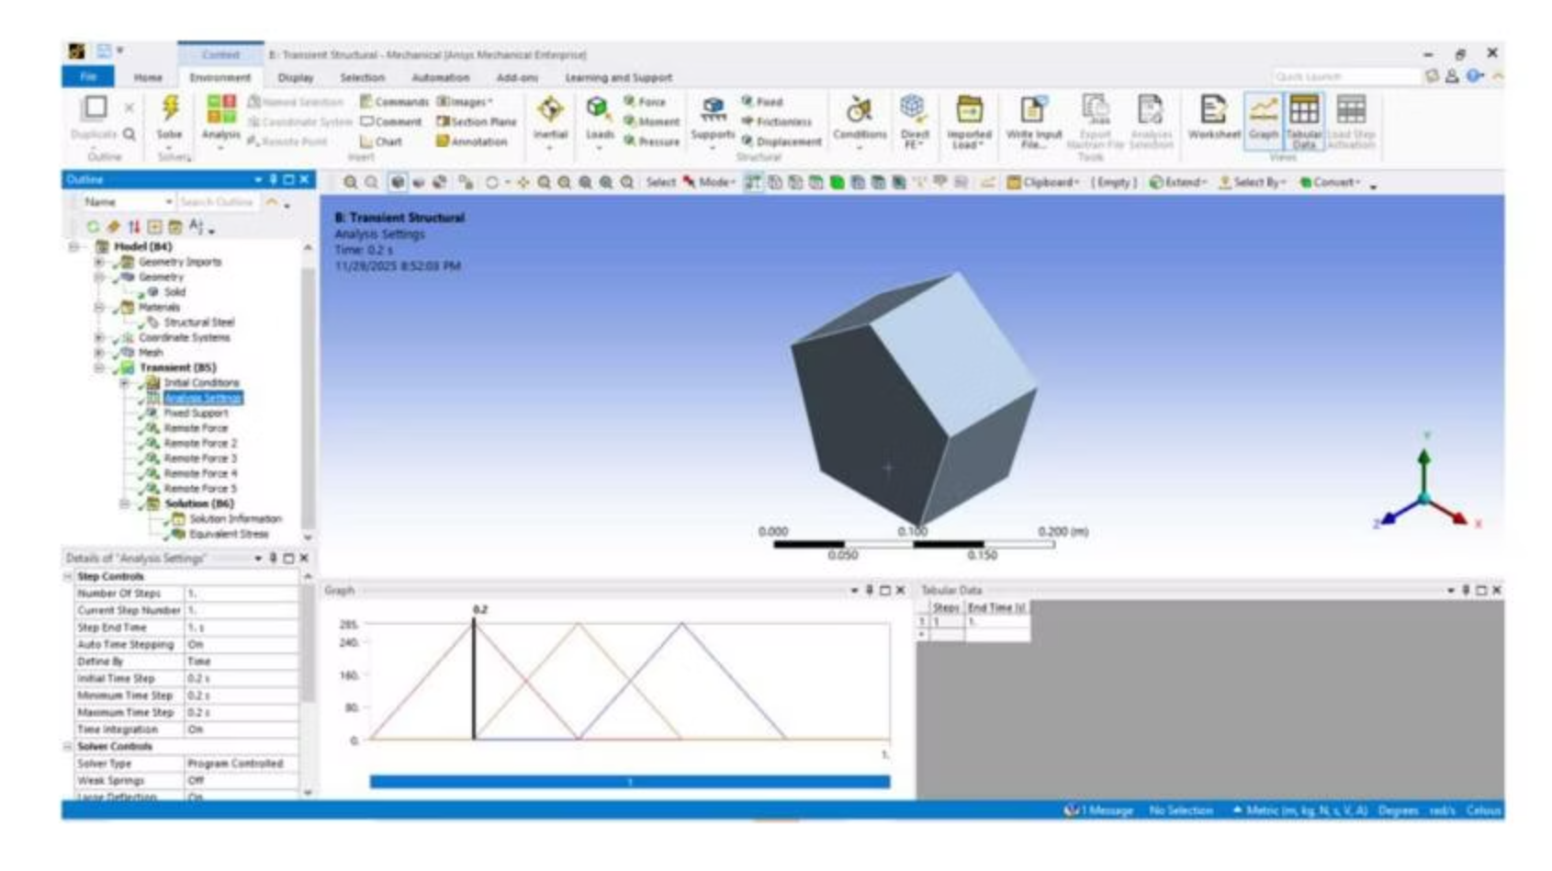
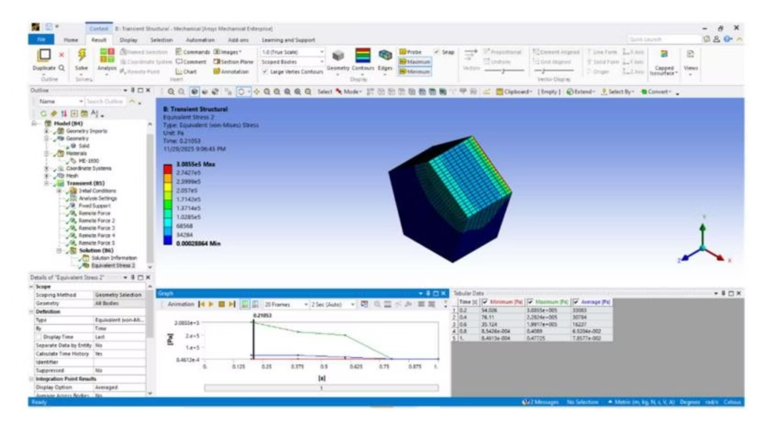
Transient Structural Analysis
1
2
3
Boundary Conditions
Analysis Settings
Transient Results
Fixed Support on one face. Five Remote Forces (285 N each) on five different faces.
Step end time: 1.0 s. Initial time step: 0.2 s. Auto time stepping: ON. Loads follow a triangular ramp-up/ramp-down.
Time-based equivalent stress distribution. Max stress: 3.0855e5 Pa at t ≈ 0.21 s, then decreases.
Fixed Support (Transient)
Multiple Remote Forces (Transient)
Analysis Settings + Load Time Graph
Equivalent Stress (Transient)

Slide 6




Observations & Conclusion
Stress Concentrations
Dynamic Response
Consistent with applied load faces in both analyses.
Transient analysis showed dynamic response to varying loads.
Mesh Quality
Successful Analyses
Acceptable for student version settings.
Both static and transient analyses were successfully performed.
The object behaves predictably under both constant and time-varying loads.

